Slide 1
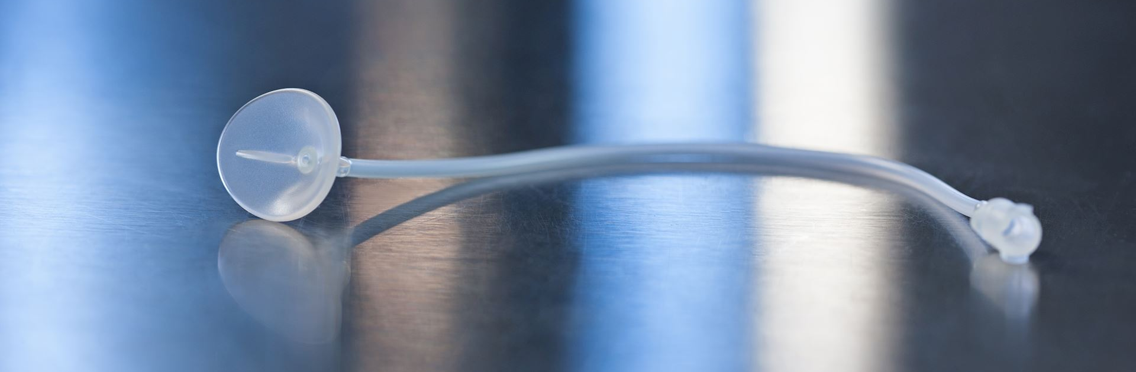

The Morgan Lens® The World’s Leading Method of Ocular Irrigation
Notes:
Introduction:
Welcome everyone. Today, I will be discussing the Morgan Lens®, the world’s leading method of ocular irrigation.

Slide 2
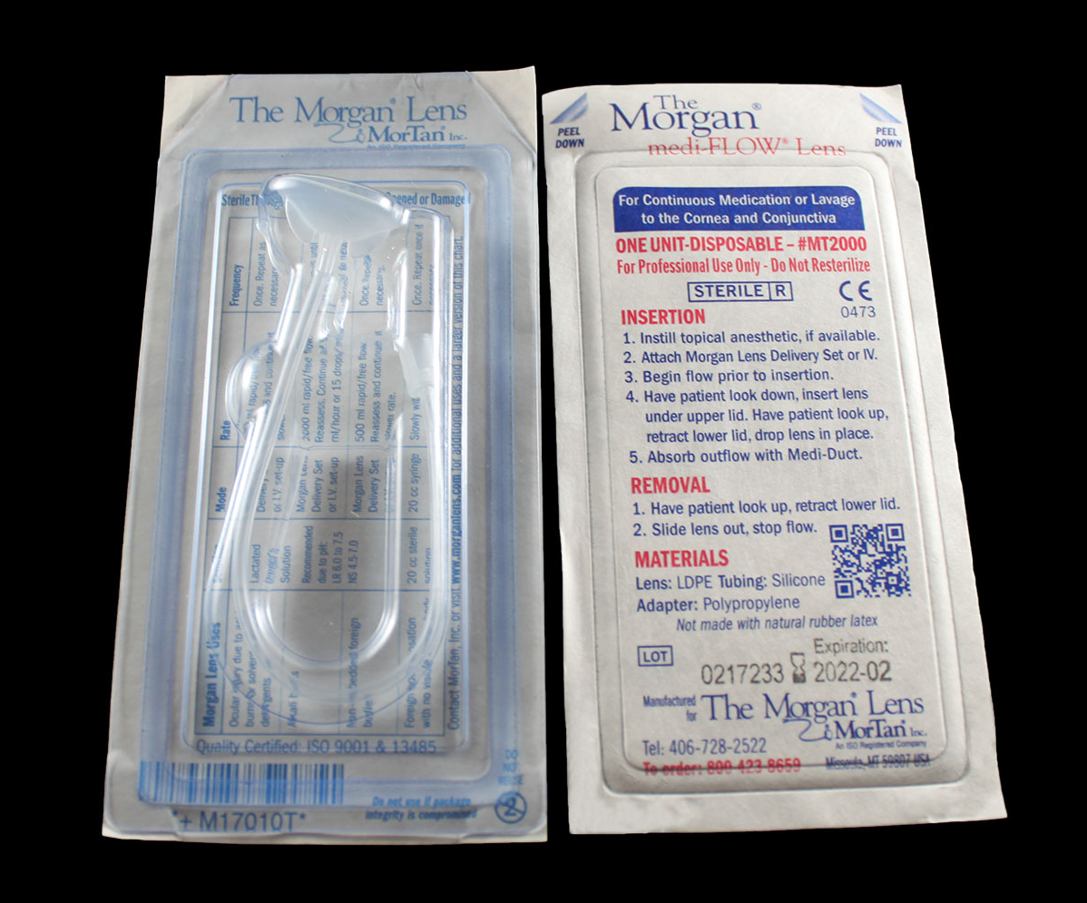
What is the Morgan Lens?
The Morgan Lens is a sterile single use medical device with a five-year expiration. It resembles the shape of a semi-hard contact lens connected to tubing. When in use, the tubing is attached the Morgan Lens Delivery Set or an administration set which is then connected to a bag of solution prior to insertion. The solution flows through the tubing through an opening in the lens to irrigate the eye.
Once inserted, it provides continuous eye irrigation without requiring constant attendance by medical personnel.
Developed by an ophthalmologist, to address the need for efficient and effective emergency eye irrigation to treat corneal ulcers, corneal perforations, severe ocular infections.
Notes:
The Morgan Lens® is a sterile, single-use medical device designed to provide continuous eye irrigation without requiring constant attendance by medical personnel.
The Morgan Lens® resembles the shape of a semi-hard contact lens connected to tubing. When in use, the tubing is attached to a bag of solution prior to insertion.
The solution flows through the tubing and an opening in the lens to irrigate the eye, providing efficient and effective treatment for various eye conditions.

Slide 3
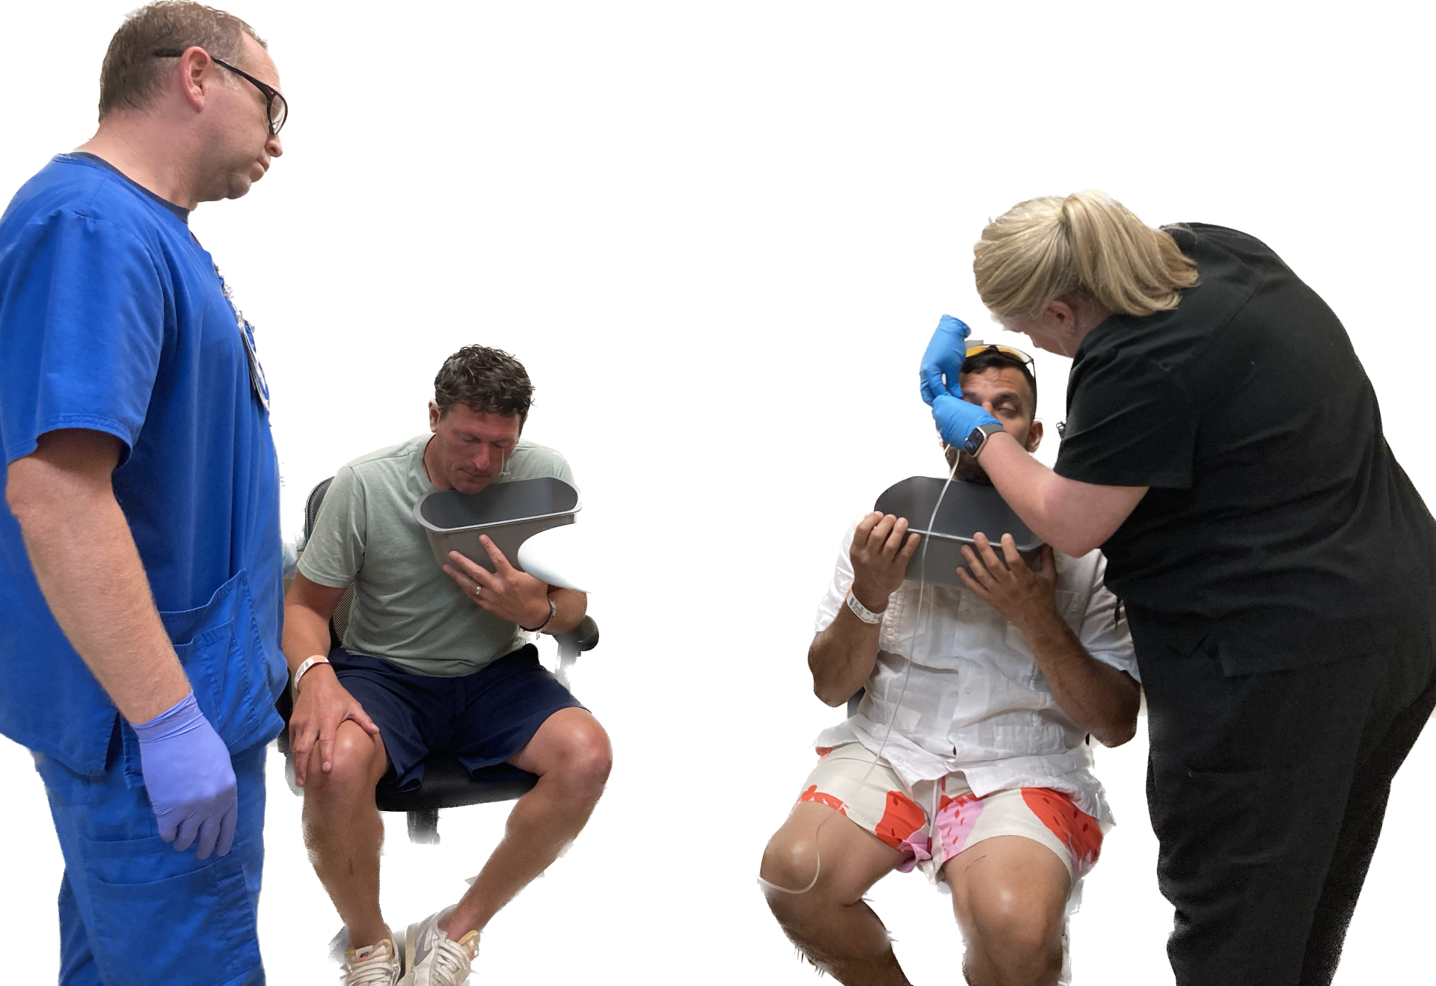
Do you have a Morgan Lens story?
Have you heard of the Morgan Lens?
Have you ever used the Morgan Lens?
Notes:
How many of you have heard of the Morgan Lens? How many of you have used it? Does anyone have a story they want to share?

Slide 4
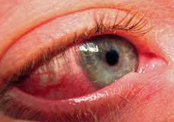
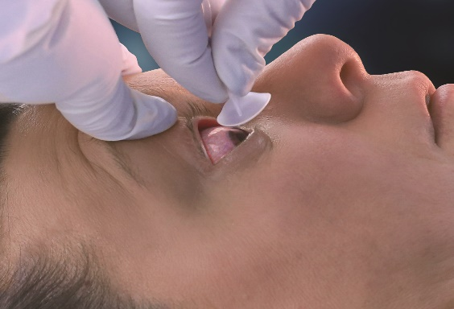
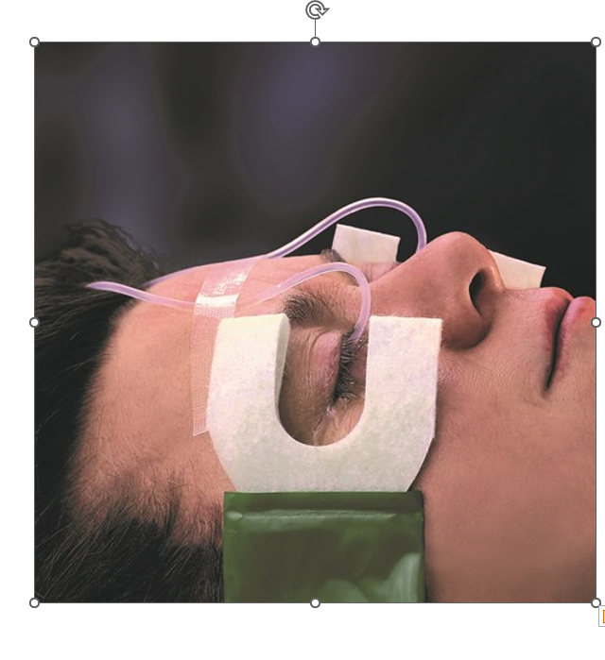
The Morgan Lens is…
Fast, effective, easy to use ocular irrigation
Hands-Free so medical personnel can treat other injuries
Used in over 90% of U.S. emergency departments
Notes:
Key Features of the Morgan Lens are that it is fast, efficient, and easy to use. Once it is inserted, the ER staff has their hands free to treat other injuries. This product does what it needs to do, it provides thorough irrigation to the patient’s eyes, greatly increasing the chance for a positive outcome and full recovery.
Ocular burns represent 7 to 10% of ocular trauma presented to EDs.
84% are chemical burns (acids to alkali ratio varies from 1:1 to 1:4 depending on the study)
15% are thermal burns
Other types of burns include “actinic” burns which result from exposure to radiant energy (UV rays from sunlight, welders, lasers, etc.)
The Morgan Lens may be used to treat chemical, thermal, or actinic burns.
15-20% of patients with facial burns exhibit ocular injury.
According to a 2023 study in Medscape, approximately 1/3 of corneal transplants were done on eyes that sustained chemical burns (Note that even if eye cannot be saved, irrigation should be performed in order to maintain enough healthy tissue to allow a corneal transplant).

Slide 5
Uses of the Morgan Lens
Alkali Burns
Acid Burns
Thermal and Actinic (UV-related) Burns
Irritants (gasoline, detergents, etc.)
Non-embedded Foreign Bodies
Foreign Body Sensation (FBS) With No Visible Foreign Body
Routine Pre-Operative
Eyelid Surgery
Severe Infection—controlled medication delivery
Notes:
WQAlkalis (also called bases) are defined as proton acceptors (OH-); their strength is measured by how aggressively they will take a proton from another compound. The pH of a base ranges from 7 to 14, with a very strong base such as sodium hydroxide (NaOH) having a pH of 14. Alkalis produce liquefaction necrosis which quickly penetrates into the inner eye. They are generally more damaging than acids.
Acids are proton donors (H+); their strength is based on how easily they give up the proton. Their pH varies from 0 to 7, and a very strong acid such as hydrochloric acid (HCl) has a pH of 1. An ocular acid burn produces coagulation necrosis of the cornea. The damaged tissue then limits further penetration of the acid.
Both acids and bases are called caustics. Concentrated forms of either may generate significant heat when in contact with water, resulting in thermal injury (this is most pronounced when just a small amount of fluid is present--as in the eye). Large amounts of fluid (irrigation) dissipates the heat in addition to diluting and removing the caustic.
A Foreign Body Sensation (FBS) may be caused by an actual particulate that can’t be seen, but it also may be the result of a corneal abrasion or erosion, or an inflammatory condition of the eye or conjunctiva. It may be more effective to skip or limit the use of an ocular anesthetic since irrigation only needs to be continued until relief is noted.
The Morgan Lens may be used for delivering a controlled dosage of medication to the eye, especially when attached to a syringe.
Please note: If a corneal abrasion is found, it was likely caused from the initial injury to the eye.

Slide 6
Ocular Chemical Burns
“Chemical burns to the eye are among the most urgent of ocular emergencies…
Copious irrigation is the most important emergency treatment of the chemically-burned eye…
The Morgan Lens eye irrigation has more of an influence on the outcome of the injury than any other therapeutic approach.”
Prompt
Prolific
Prolonged
Notes:
Quoted from a doctor in an Occupational Health & Safety publication.
Effective treatment MUST BE:
1. PROMPT: Must be started as soon as possible--treatment should NOT wait until arrival at the Emergency Department, and/or should be started immediately when the patient arrives at the ER.
2. PROLIFIC: Must reach all regions of the eye and inner eyelid, diluting and/or washing away any caustics.
3. PROLONGED: Must be continued uninterrupted for a sufficient period of time (for chemical burns, until the pH returns to neutral. Note that this may take hours).
MorTan, recommends the use of lactated Ringer's (Hartmann's solution) since it has a pH similar to that of tears and because of its buffering capacity. However, irrigation may be done using "water...beer, urine, or any other reasonably safe fluid." (Principles and Practices of Emergency Medicine, Third Edition, Schwartz, et.al.).

Slide 7
Alkali Burns (bases)
Most serious of all ocular burns
Penetrate rapidly, increasing pH of anterior chamber
Can cause severe damage to collagen, nerve endings, keratocytes, the iris and ciliary body
Loss of corneal epithelium leads to increased risk of infection
Common materials that contain alkali:
Lye (in drain cleaners)
Lime (in plaster, cement)
Ammonia (in fertilizers, cleaning agents)
Motor vehicle airbags
Fireworks
Notes:
Alkali burns are THE MOST SERIOUS OCULAR BURNS as they rapidly cause liquefactive necrosis (saponification of fatty acids of cell membranes with an associated inflammatory response (release of proteolytic enzymes) which causes further damage). Damage continues as the alkali rapidly penetrates through ocular tissues, generally taking 5 to 15 minutes to reach the anterior chamber.
Note that alkali burns may not be the most painful: the alkali can quickly penetrate the corneal stroma, interfering with sensory nerves. The nerve damage may actually produce an anesthetic effect as the alkali continues penetrating into the anterior chamber and retina. Do not use pain as an indicator of severity.
Automobile air bags are a growing cause of alkali burns. A chemical reaction of sodium azide inflates the bag, but also produces aerosolized powdered sodium hydroxide (a strong base). In addition, there may be inert powders used to prevent sticking and these can cause irritation. Often the pain is delayed (or less significant than other injuries) and irrigation is delayed, resulting in a more serious injury.
Sodium and Potassium Hydroxide - found in cleaners, drain openers, lye soap, denture cleaners, paint removers and is often used in food processing. It is also found in Clinitest tablets (45-50%). Considerable heat is generated when mixed with water (Clinitest tablets generate temperatures of nearly 160 degrees F when dissolved in 1.5 mL of water).
Calcium Hydroxide - found in household bleach and pool chlorination solutions.
Calcium oxide (lime) - a caustic ingredient in cement; generates heat when mixed with water.
Ammonia – found in cleaners and detergents. Gaseous anhydrous ammonia is used in fertilizer manufacturing.
Phosphates – found in many household detergents and cleaners.
Magnesium hydroxide and Phosphorus - found in fireworks, sparklers and flares.

Slide 8
Acid Burns
Immediately denature proteins
Opacifies cornea, slows deep penetration
Eye initially may look worse than alkali burn
although damage often is not as severe
Common Acids:
hydrofluoric* sulfuric nitric hydrochloric sulfurous acetic
Most common sources:
Industrial accidents and automobile battery explosions
*Hydrofluoric Acid Burns-very serious
HF penetrates quickly and acts like an alkali
Notes:
Hydrofluoric acid is a weak acid that produces liquefaction necrosis and therefore acts more like an alkali (these burns are very serious and often extremely painful, although the onset of pain may be delayed for hours). It may be found in glass etching compounds, rust removers, cleaners, refrigerants, leather tanning products, and used in manufacturing and refining processes.
Sulfuric acid generates considerable heat when diluted. It is found in automobile batteries, cleaners (toilet bowl, drain, metal), and is used in chemical or fertilizer manufacturing. Concentrations range from 8% to almost pure acid.
Nitric acid is used in metal refining, electroplating, engraving, manufacturing.
Hydrochloric acid is found in cleaners (toilet bowl, metal, swimming pool), plumbing applications, laboratory chemicals. Concentrations range from 5 to 44%.
Acetic acid is found in printing agents, disinfectants, hair care products. Vinegar is dilute acetic acid.
Formic acid is used in airplane glue and manufacturing.
The word “acid” comes from the Latin acidus which means sour, since it was noticed that many acids have a sour taste (for example, citric acid in lemons or acetic acid in vinegar, and milk turns sour due to the formation of lactic acid).

Slide 9
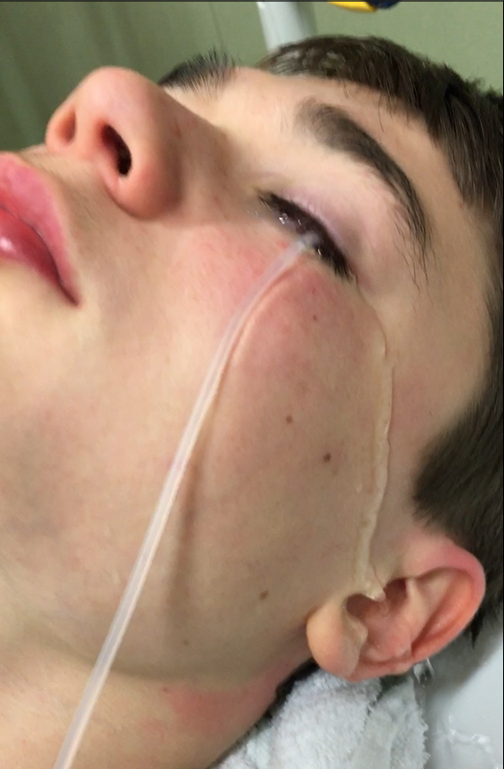
Irritants
Irritants cause more discomfort than actual damage
Common Irritants:
Gasoline
Tactical & Defense Sprays (“Pepper” Spray)
Some Household Detergents
Note: Liquid detergent capsules may form alkalis when dissolved in water
Irritants are substances with a neutral pH
Notes:
It’s not necessary to monitor pH when removing an irritant.
Irrigation should be continued until the pain is gone (usually 20 to 30 minutes minimum), keeping in mind that an ocular anesthetic may block the sensation.
Continue with eye assessment procedures and treat accordingly.
Note that liquid detergent capsules contain anionic and non-ionic detergents and cationic surfactants, but an alkali solution forms when dissolved in water. One study at the Western Eye Hospital in London found that 40% of all chemical ocular injuries in children under 5 years of age were caused by detergent capsules.

Slide 10
Issues with Alternative Methods
The eyes must be manually held open, or the patient has to blink repeatedly for the fluid to reach the cornea.
Keeping the eyes open may be extremely painful.
Fluid will take the “path of least resistance” and simply flow off the surface rather than flushing the fornices.
Locating components and assembly may be required.
Retracted eyelids may have pockets that can trap chemicals.
Continual contact with burned skin around the eye may be necessary to keep the eye open.
Full-time attention is required for the irrigation process.
Notes:
Irrigation should be started as quickly as possible using any available method and safe fluid. However, the Morgan Lens should be in place promptly in order to ensure effective irrigation.
The Morgan Lens eliminates the problems associated other methods of irrigation. Some of these issues are:
-at least one medical provider is needed to hold the eyelids open (possibly more for bilateral irrigation or for treating children)
-an increased sensitivity to light (photophobia) and the reflex action of the eyelids (blepharospasms) make it painful to keep the eyes open during the irrigation process
-the fluid is not directed under the eyelids so that much of it will run off the surface, never reaching into the fornices or flushing the inner eyelids
-some irrigation methods require materials that may not be readily available in the ER or need modification
-it may be difficult to effectively irrigate the folds formed when retracting the eyelids, and any trapped particulates or chemicals may continue to contaminate the eye
-continual and painful touching of the burned skin around the eye may be required to keep the eye open in order to deliver fluid to the cornea
-medical personnel are not free to treat other injuries or patients

Slide 11
Materials Used for Irrigation with The Morgan Lens
Two Morgan Lenses
Note: Pain in one eye may mask pain in other--irrigate both unless injury is known to be limited to one eye
Morgan Lens Delivery Set®
Medi-Duct ® to absorb outflow
Suitable Irrigation Solution—
lactated Ringer’s (Hartmann’s Solution) recommended
pH Paper
Optional materials:
Topical ocular anesthetic if available
Notes:
The Morgan Lens has a standard luer lock adapter that can attach to an I.V. set or a Morgan Lens Delivery Set which can provide irrigation to one or both eyes.
Morgan Lens Delivery Set:
-a specialized tubing set (giving set)
-branches to allow attachment to two Morgan Lenses
-provides simultaneous irrigation of both eyes (clamp included to allow irrigation of one eye)
-eliminates the need for two separate bags of solution, tubing sets, and I.V. poles
Medi-Duct:
-an ocular fluid management system
-designed specifically for use with the Morgan Lens
-adhere to the side of the face next to the irrigated eye
-wicks away irrigating fluids with super absorbent material keeping patient dry
-allows for easy collection and disposal
Topical Anesthetic:
-not required when using the Morgan Lens
-may reduce patient anxiety, ease the insertion of the lens
-reduces reflex squeezing action of lids (blepharospasm)
-may be re-instilled during irrigation by temporarily pinching tube of the Morgan Lens while placing a drop into the eye (removing the lens from the eye is not necessary)
Irrigating Solution:
-lactated Ringer’s (LR) recommended due to the similarity in pH to that of the eye
-Hartmann’s solution is very similar to LR and may be used when available
-some patients experience irritation with Normal Saline especially on prolonged irrigation—switching to LR has been shown to relieve pain
-experts recommend using any safe solution—do not delay irrigation to find an ideal solution
pH paper:
-allows medical staff to test pH level in eye(s)
-pH may be taken by temporarily pinching the tube of the Morgan Lens to stop the flow
-irrigation should be continued until the pH is neutral and remains stable

Slide 12
Contraindications
PROTRUDING FOREIGN BODY
PENETRATING EYE INJURY
SUSPECTED OR ACTUAL RUPTURE OF THE GLOBE
**DO NOT INSTILL TOPICAL ANESTHETIC AGENTS IF PATIENT ALLERGIES ARE KNOWN**
Notes:
The Morgan Lens may be used with non-embedded foreign bodies, but DO NOT USE if there is any type of penetrating eye injury or a protruding foreign body.
Ensure the patient does not have any known allergies to ocular anesthetics if used.

Slide 13
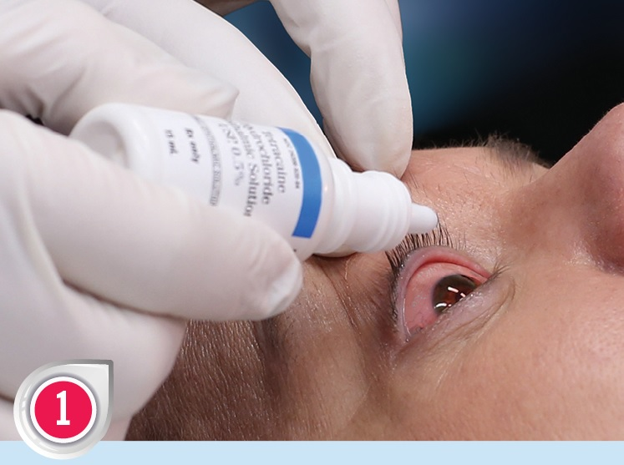
Morgan Lens Insertion
Step One:
Instill topical ocular anesthetic (if available). Make sure to ask the patient if they are allergic to any medications before administering the anesthetic. The most commonly used are proparacaine, tetracaine or lidocaine.
Note:
Anesthetic is not required but may help relieve blepharospasms and pain
*DO NOT DELAY IRRIGATION TO REMOVE CONTACT LENSES unless it can be done rapidly. Instead, irrigate over lenses as they may be easier to remove later.
Notes:
Insertion, Step One:
-Ensure the patient does not have any allergies which would prevent using an anesthetic.
-If available, instill topical anesthetic (pain and blepharospasms—the involuntary reflex action of squeezing the eyelids shut--may be relieved by an anesthetic, thereby helping with insertion).
Irrigation with the lens may still be performed if anesthetic isn’t available. The irrigating solution will cool and soothe the eye, dilute the contaminant, and the eyelids may be shut.
Note that anesthetics may mask the feeling of a foreign body, so for the removal of particulates or for a foreign body sensation, it may be best not to use an anesthetic.
-DO NOT DELAY IRRIGATION to remove contact lenses unless it can be done rapidly. Instead, irrigate over the lenses as they may be easier to remove later. Chemically-contaminated lenses should be discarded.

Slide 14
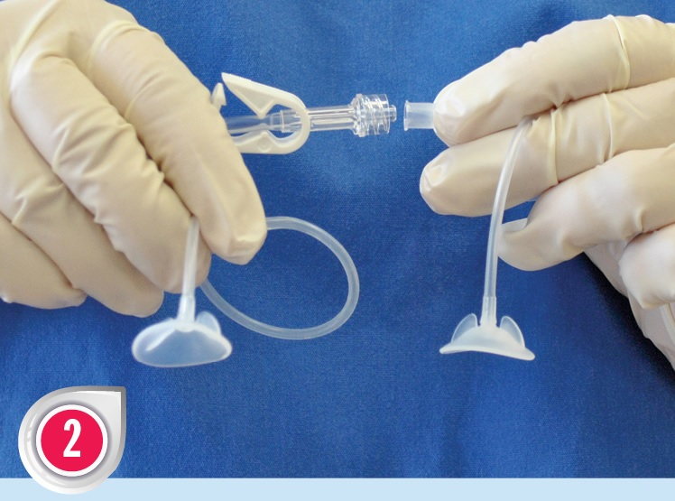
Morgan Lens Insertion
Step Two:
Peel open the sterile packaging and attach the Morgan Lens to the Morgan Lens Delivery Set
Two lenses may be attached to one Delivery Set to simultaneously irrigate both eyes
Note:
Standard administration sets or a 20cc syringe may also be used
Notes:
Insertion, Step Two:
-Attach the Morgan Lens to a Morgan Lens Delivery Set or a standard I.V. set. You can use the clamp on the Morgan Lens Delivery Set to close off one side of tubing if only irrigating one eye.
-For a smaller, more controlled dosage (including foreign body removal), a syringe may be used.
-The pain in one eye may mask pain in the other, so consider irrigating both eyes unless there is clear evidence that only one is involved. -Bilateral irrigation may be done using two Morgan Lenses and two I.V. setups or one Delivery Set.

Slide 15
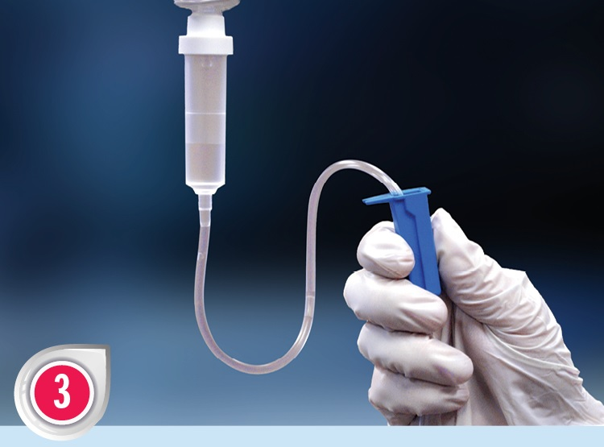
Morgan Lens Insertion
Step Three:
Using solution and rate of choice,
START A MINIMAL FLOW
Note:
This allows the lens to “float” over the cornea and sclera
**Continue the flow of solution until after the lens is removed**
Notes:
Insertion, Step Three:
-Start a minimal flow of the irrigating solution BEFORE insertion. This immediately starts the irrigation process plus it allows the lens to float on the solution after insertion.
MorTan, recommends the use of lactated Ringer’s Solution (Hartmann’s Solution) although any safe fluid may be used to start irrigation as quickly as possible.

Slide 16
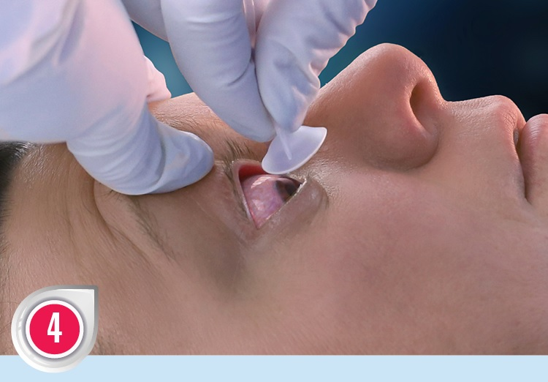
Morgan Lens Insertion
Step Four:
Have patient look down, insert the Morgan Lens under upper lid.
Have patient look up, retract lower lid and drop the Lens in place.
Release lower lid over lens.
Note:
The sclera is exposed when patient looks down.
Notes:
Insertion, Step Four:
-Maintain a minimal flow of irrigating solution.
-Have the patient look down. This exposes the tough and less-sensitive sclera (and the patient is not looking at the lens).
-Insert lens under the upper lid.
-Have the patient look up, retract the lower lid, and drop lens into place.
-Release the lower lid over the lens.
Note that if a patient is unable or unwilling to comply with verbal instructions (too young, unconscious, etc.), the Morgan Lens may be inserted without requiring the patient to look down.

Slide 17
Morgan Lens Insertion
Step Five:
Adjust the flow to the desired rate and absorb the outflow with the Medi-Duct
Secure the Medi-Duct by adhering it to the side of the face next to the irrigated eye
Continue irrigation until pH of eye returns to normal
Note:
Tape the Morgan Lens tubing to patient’s forehead to prevent accidental removal.
**DO NOT LET SOLUTION RUN DRY**
Notes:
Insertion, Step Five:
-The flow may be adjusted to the desired rate (see MorTan’s Recommended Uses Chart)
-A Medi-Duct may be taped to the side of the patient's face as close to the eye as you can get it to direct the outflow into a basin or other receptacle. Gently hold the wicking material on the face until damp. Once the wicking material is damp, it will start to pull away the fluid. Towels, blue pads, chux pads, an adult diaper or an emesis basin may also be used.
-Taping the tubing to the patient’s forehead may prevent accidental removal.
-For chemical burns, irrigation should be continued until the pH returns to normal and remains steady. This may take at least 2 to 3 hours for alkali burns, but often longer.
CONTINUE THE FLOW OF SOLUTION UNTIL AFTER THE REMOVAL OF THE LENS-the solution gently pushes the lens away from the cornea and provides a cushioning layer for the lens to float on
Note that if the fluid is stopped, the lens is designed to vault the cornea and will not touch it, instead contacting the sclera. Refer to the Morgan Lens IFU for more information on flow rate and duration.

Slide 18
All Three Products In Use
In use on patient: Two Morgan Lenses, two Medi-Ducts, and one Morgan Lens Delivery Set.
Notes:
Image of all three Morgan Lens products in place.

Slide 19
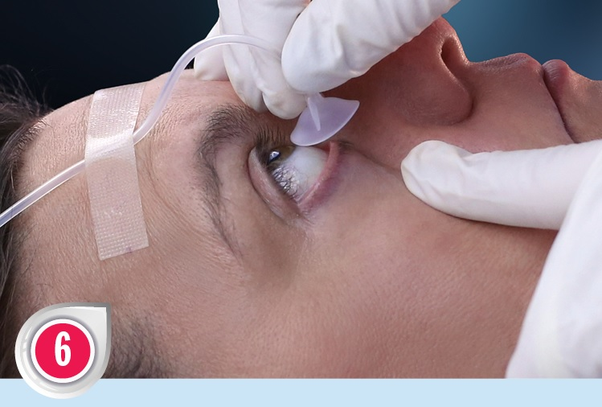
Morgan Lens Removal
Step Six:
CONTINUE FLOW
Have patient look up and Retract and hold lower lid
Slide Morgan Lens out
TERMINATE FLOW OF SOLUTION
Place the Morgan Lens in a clean location (such as the opened package)
Note:
After removal, check ocular pH every 5 to 10 minutes to ensure stability
Remove the Medi-Duct once you are sure irrigation is complete
Notes:
Continue flow of irrigating solution until the lens has been removed—DO NOT RUN DRY so that the lens continually floats above the cornea
Temporarily store the lens in a clean location (such as the opened package) and check the ocular pH after every 5 to 10 minutes to ensure that it has not changed. Reinsert lens and continue irrigation if necessary. Once the pH has stabilized, discard the used Morgan Lens and other materials according to your hospital’s disposal protocols.
--Again, remember to use the Morgan Lens Instructional Chart for additional instructions or for the treatment of other injuries--

Slide 20
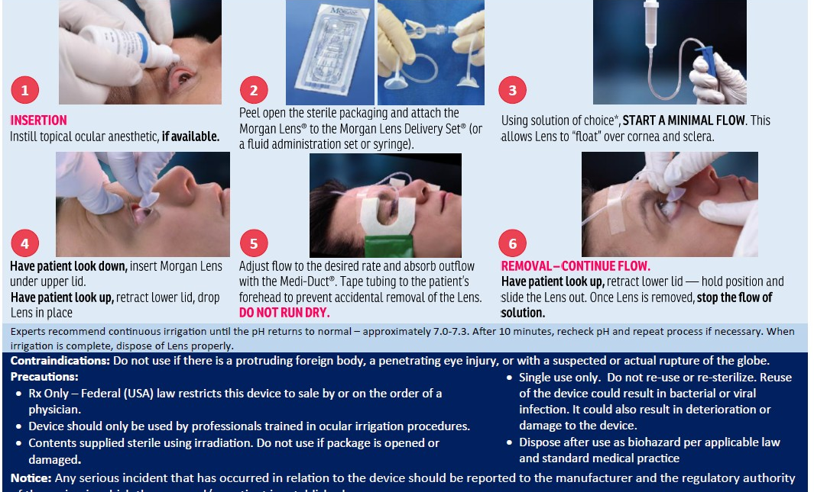
Recap: Six Steps of Insertion and Removal

Slide 21
Irrigation Times
For Irritants, solvents, non-embedded foreign bodies:
20 to 30 minutes minimum using 1 liter of solution
For Acids and Alkalis:
Irrigate with at least 2 liters of fluid per eye
Check pH of medial canthus
If neutral, remove the Lens, wait 5-10 minutes
Measure pH of medial canthus
Repeat irrigation until pH remains between 6.5 and 7.6
For very strong acids or alkalis, continue irrigation for 2 hours after reaching surface pH of 7.0-7.3 to ensure neutralization of the anterior chamber
Notes:
If the offending agent is not chemically reactive (irritants, solvents, non-embedded foreign bodies, etc.), experts usually recommend using 1 liter of solution or irrigating for approximately 30 minutes. For acids and alkalis, the measurement of conjunctival pH can be used to determine the stopping point as described below.
When checking for pH stabilization, the lens should be stored in a clean, particle-free location (such in the original package) in case further irrigation is necessary.
The normal pH of tears is 6.5 to 7.6. In order to measure the pH of the eye and not the irrigating solution, pinch the tube of the Morgan Lens to temporarily stop the flow of solution and measure the ocular pH in the medial canthus; it is not necessary to remove the lens.

Slide 22
Questions for Patients *Do NOT delay irrigation to take patient history*
When did injury occur?
What substance was involved?
Is the patient on any medication?
Was the patient wearing safety glasses when injury occurred?
Are there any other injuries?
Did patient receive any prior treatment?
Notes:
BEGIN IRRIGATION FIRST, ASK QUESTIONS LATER
The severity of the injury depends upon:
Length of contact time, pH (molarity), concentration, viscosity, volume, and physical form of contaminant, heat created by reaction, and associated toxic substances.
DO NOT DELAY the initiation of irrigation to remove contact lenses. Contacts were once thought to trap chemicals underneath or to absorb vapors in the air. Studies have shown that neither of these occur, at least with the chemicals studied. Contact lenses, either hard or soft, may actually form a barrier that prevents or lessens chemical burns, and soft contacts do not increase exposure of the cornea to vapors (Journal of the Contact Lens Association of Ophthalmologists, January, 1992, and summarized in Scientific American, April, 1998)

Slide 23
Lactated Ringer’s vs. Normal Saline
MorTan, recommends the use of lactated Ringer’s (Hartmann’s Solution) because it the pH is closer to that of the tears
pH of tears: approximately 6.5 to 7.6
pH of lactated Ringer’s: 6.0 to 7.5
pH of Normal Saline: 4.5 to 7.0
Buffering capacity
lactated Ringer’s solution returns pH to neutral more quickly
with either acidic or basic contaminants*
Increased patient tolerance Normal Saline may cause discomfort and/or morphological
changes to the eye*
*from independent studies
Notes:
MorTan, Inc. recommends the use of lactated Ringer's solution for irrigating due to pH:
-tears pH: approximately 6.5-7.6
-lactated Ringer's pH: 6.0-7.5
-Normal Saline pH: 4.5-7.0
(Please note: Variations of pH levels are due to different batches or manufacturers of the solutions)
The buffering capacity of the lactate ion found in lactated Ringer's solution returns the pH to normal more quickly when used with either acidic or basic contaminants*
Normal Saline may cause discomfort and/or morphological changes in prolonged irrigation*
Lactated Ringer’s solution is very similar to Hartmann’s Solution
*from independent studies

Slide 24
Suggestions for the “Difficult Patient”
Reassure the patient: insertion will quickly relieve pain.
Seconds count!
The irrigating solution provides cooling and soothing sensation
Any delay will cause further damage
The injured cornea is protected from “squeegee” action of eyelids each time the patient blinks
Remind them their eyes may be closed during procedure, usually this is more comfortable for them
Chemicals may generate heat when mixed with water- irrigation will cool the eye
A topical anesthetic may help relieve anxiety. Additional anesthetic may be instilled without removing lens. Pinch tubing and instill drop into medial canthus
Remember: The Morgan Lens does not touch the cornea, it is designed to vault the cornea
Notes:
Assure the patient that the irrigating solution will be soothing and cooling and, by inserting the Morgan Lens, the eyelids may be closed. The fluid will immediately begin diluting and removing the contaminant and alleviating pain. The alternatives require that the eye be opened (fighting blepharospasms and photophobia) and often do not deliver sufficient fluid to the injury so that neutralization is prolonged.
Explain that you will only need a few seconds to insert the lens, briefly touching the possibly-sensitive skin around the eye, and as soon as the lens is in place, no further contact is necessary.
By having the patient look down (Step 4 in the Instructions for Use), the person is not looking at the lens while it’s being approaching the eye, plus the sclera is less sensitive and tougher than the cornea.
Keep in mind the extra anxiety that is generally associated with an ocular injury and reassure the patient that you are using the best treatment method available.
Use common sense: telling a patient "this is going to hurt" almost guarantees that a procedure will (especially with children). Instead, saying "this will feel cool“, unless you've warmed the solution, or reminding them that the lens will not be touching the cornea (since it floats on the irrigating solution) may help relieve anxiety.
If using Normal Saline, remember that its low pH may make it difficult for some patients to tolerate (especially for long term). Switching to lactated Ringer's (Hartmann's solution) may help as their pain may be coming from the irrigating solution and not the irrigation procedure. Do not delay irrigation in order to find the best solution—begin irrigation as quickly as possible.
Ensuring that all materials are readily available by having an eye cart or tray may eliminate delays in starting irrigation.
It may help to have a parent hold a small child during the irrigation process.

Slide 25
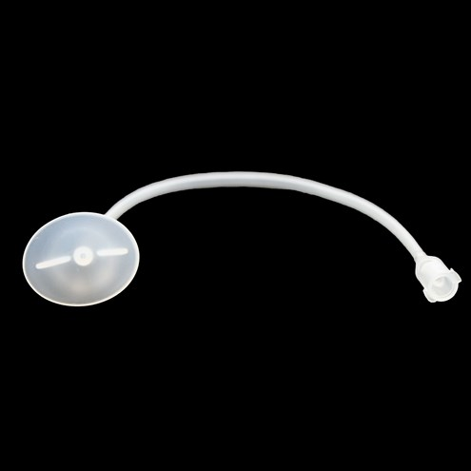
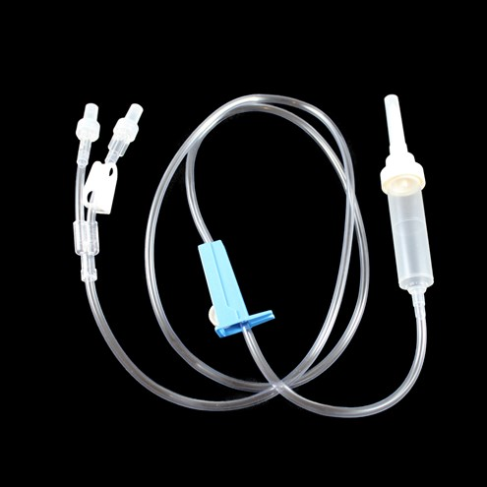
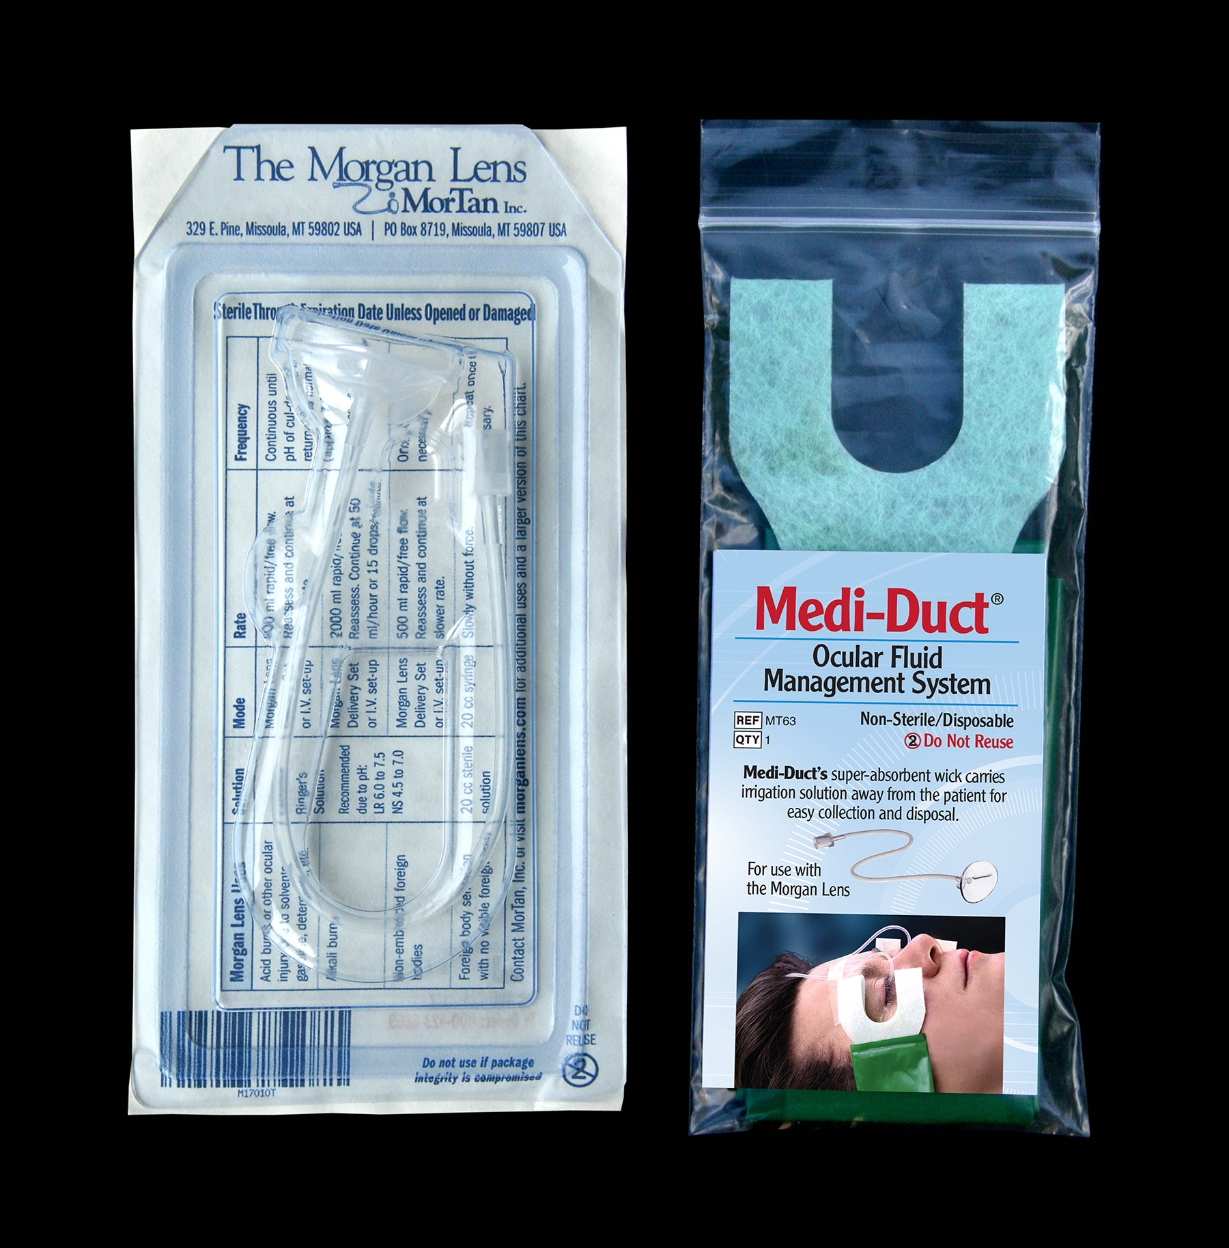
Morgan Lens Products
Morgan Lens
Medi-Duct
Delivery Set
Morgan Lens
Convenience Kit
Notes:
Here are all four products that MorTan, Inc. sells. Going from left to right, the primary product is the Morgan Lens, next is the Medi-Duct which keeps the patient drier, the Delivery set allows for bilateral irrigation with one bag of solution, and the Morgan Lens Convenience Kit has one Morgan Lens and one Medi-Duct packaged together, making it easier and less expensive to use the Morgan Lens and the Medi-Duct will keep the patient drier.

Slide 26
Helpful Tips
Best positions for the patient to be during eye irrigation with the Morgan Lens are reclined or supine.
Make sure the solution is flowing BEFORE inserting and do not stop flow of solution until AFTER removal.
When using the Medi-Duct, adhere it as close to the corner of the eye as you can. Let the wicking material get a little damp with solution by holding your fingers on it. This will help it wick the solution away better.
Don’t turn off the solution when checking the pH, just pinch the tubing to temporarily stop the flow.
Turn the lens vertical to insert it for a younger child. Once under the upper lid, turn it horizontal.
On a chemical burn, you want it flowing as much as possible, but some patients cannot handle that, so slow it down if the patient is uncomfortable.
Irrigate BOTH eyes.
Some patients like warm solution.
Eye irrigation can lower people’s blood pressure so monitor their blood pressure
Notes:
Go over these helpful tips and ask if there are any questions.

Slide 27
Summary
Ocular irrigation should be immediate and continued until pH of the eye returns to normal *(alkali burns may require hours of continuous irrigation; severe infections may require irrigation for hours or even days)*
Used in 90% of emergency departments in the US. Also used in urgent cares, EMS, military, correctional facilities, and industrial medical sites.
The most thorough efficient and effective way to irrigate the eye.
Education and Location:
Do you know where the Morgan Lens is stored for use in your facility?
Do you have the Morgan Lens training tool?
Have you watched the Instructional video on Morgan Lens website? www.morganlens.com
Complete Training Materials Page under the Resources Tab on Morgan Lens website.
*See MORGAN LENS USES CHART available on the Morgan Lens training page on the website.
*Be sure your facility has a Morgan Lens training tool that your staff can use for training.
Notes:
Summary:
-loss of vision is considered one of the most debilitating of injuries, and ocular burns may lead to blindness if not treated quickly and effectively
-irrigation should be prompt and prolific; any delays may alter the prognosis
-it is essential that the irrigating solution reach all regions of the eye and a sufficient volume of fluid must be used
-burns may require hours of irrigation in order to neutralize the pH (and to ensure that the pH remains neutral)
-irrigating continuously for days may be necessary to effectively treat severe infections

Slide 28


The World’s Leader in Ocular Irrigation
MorTan, Inc. Contact Us
P.O. Box 8719
Missoula, MT 59807 USA
Phone: 1-800-423-8659
or (406) 728-2522
www.morganlens.com email: mortan@morganlens.com
All Morgan Lens products are FDA registered, ISO 9001, MDSAP, EU-MDR certified and compliant with all regulatory requirements.
Please do not duplicate or modify this presentation without permission from MorTan, Inc.
Notes:
Speaker notes were compiled using numerous sources including:
“Burns, Ocular” by Wende R. Reenstra-Buras, MD
http://www.emedicine.com/EMERG/topic736.htm
“Burns, Chemical” by Robert Cox, MD
http://emedicine.medscape.com/article/769336-overview#a4
Principles and Practices of Emergency Medicine (Third Edition, Schwartz, et.al.)
“Go With the Flow During an Eye Emergency”, Nursing 2000, Vol. 30, No. 8

