Slide 1
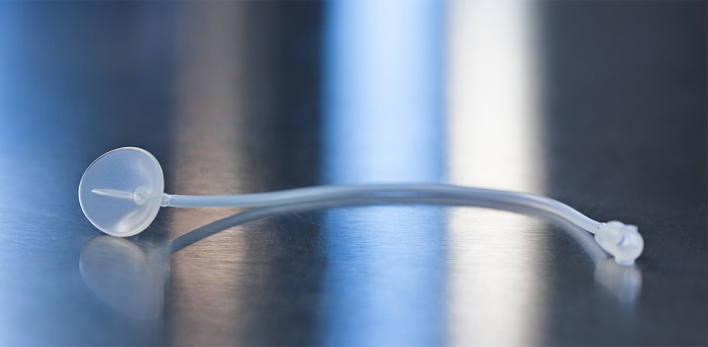
Ocular Chemical Burns- “Chemical burns to the eye are among the most urgent of ocular emergencies… Copious irrigation is the most important emergency treatment of the chemically-burned eye… This procedure probably has more of an influence on the outcome of the injury than any other therapeutic approach.”
Notes:
Quoted from “Prompt Irrigation of Chemical Eye Injuries May Avert Severe Damage”, Frank R. Burns, MD, Occupational Health & Safety, April, 1989
Effective treatment MUST BE:
1. PROMPT: Must be started as soon as possible--treatment should NOT wait until arrival at the Emergency Department, or should be started immediately when the patient arrives at the ER
2. PROLIFIC: Must reach all regions of the eye and inner eyelid, diluting and/or washing away any caustics
3. PROLONGED: Must be continued uninterrupted for a sufficient period of time (for chemical burns, until the pH returns to neutral. Note that this may take hours).
MorTan recommends the use of lactated Ringer's (Hartmann's solution) since it has a pH similar to that of tears and because of its buffering capacity. However, irrigation may be done using "water...beer, urine, or any other reasonably safe fluid." (Principles and Practices of Emergency Medicine, Third Edition, Schwartz, et.al.)

Slide 2
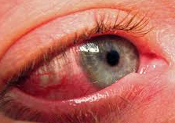
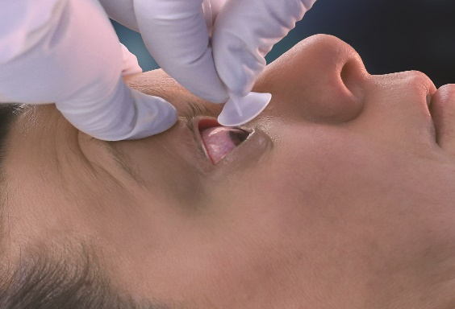
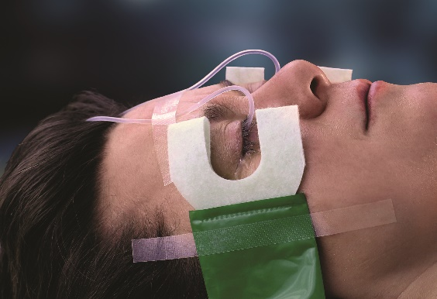
The Morgan Lens® The World’s Leading Method of Ocular Irrigation
Fast, effective, easy to use ocular irrigation
Frees medical personnel to treat other injuries
Developed by a practicing ophthalmologist
Used in over 90% of U.S. emergency departments
Notes:
Ocular burns represent 7 to 10% of ocular trauma presented to EDs.
84% are chemical burns (acids to alkali ratio varies from 1:1 to 1:4 depending on the study)
15% are thermal burns
Other types of burns include “actinic” burns which result from exposure to radiant energy (UV rays from sunlight, welders, lasers, etc.)
The Morgan Lens may be used to treat chemical, thermal, or actinic burns
15-20% of patients with facial burns exhibit ocular injury
In 1995, approximately 1/3 of corneal transplants were done on eyes that sustained chemical burns (Note that even if eye cannot be saved, irrigation should be performed in order to maintain enough healthy tissue to allow a corneal transplant).

Slide 3
Uses of the Morgan Lens
Alkali Burns
Acid Burns
Thermal and Actinic (UV-related) Burns
Irritants (gasoline, detergents, etc.)
Non-embedded Foreign Bodies
Foreign Body Sensation (FBS) With No Visible Foreign Body
Routine Pre-Operative
Eyelid Surgery
Severe Infection—controlled medication delivery
Notes:
Alkalis (also called bases) are defined as proton acceptors (OH-); their strength is measured by how aggressively they will take a proton from another compound. The pH of a base ranges from 7 to 14, with a very strong base such as sodium hydroxide (NaOH) having a pH of 14. Alkalis produce liquefaction necrosis which quickly penetrates into the inner eye. They are generally more damaging than acids.
Acids are proton donors (H+); their strength is based on how easily they give up the proton. Their pH varies from 0 to 7, and a very strong acid such as hydrochloric acid (HCl) has a pH of 1. An ocular acid burn produces coagulation necrosis of the cornea. The damaged tissue then limits further penetration of the acid.
Both acids and bases are called caustics. Concentrated forms of either may generate significant heat when in contact with water, resulting in thermal injury (this is most pronounced when just a small amount of fluid is present--as in the eye). Large amounts of fluid (irrigation) dissipates the heat in addition to diluting and removing the caustic.
A Foreign Body Sensation (FBS) may be caused by an actual particulate that can’t be seen, but it also may be the result of a corneal abrasion or erosion, or an inflammatory condition of the eye or conjunctiva. It may be more effective to skip or limit the use of an ocular anesthetic since irrigation only needs to be continued until relief is noted.
The Morgan Lens may be used for delivering a controlled dosage of medication to the eye, especially when attached to a syringe.

Slide 4
Alkali Burns (Bases)
Most serious of all ocular burns
Penetrate rapidly, increasing pH of anterior chamber
Can cause severe damage to collagen, nerve endings, keratocytes, the iris and ciliary body
Loss of corneal epithelium leads to increased risk of infection
Common materials that contain alkali:
Lye (in drain cleaners)
Lime (in plaster, cement)
Ammonia (in fertilizers, cleaning agents)
Motor vehicle airbags
Notes:
Alkali burns are THE MOST SERIOUS OCULAR BURNS as they rapidly cause liquefactive necrosis (saponification of fatty acids of cell membranes with an associated inflammatory response (release of proteolytic enzymes) which causes further damage). Damage continues as the alkali rapidly penetrates through ocular tissues, generally taking 5 to 15 minutes to reach the anterior chamber.
Note that alkali burns may not be the most painful: the alkali can quickly penetrate the corneal stroma, interfering with sensory nerves. The nerve damage may actually produce an anesthetic effect as the alkali continues penetrating into the anterior chamber and retina. Do not use pain as an indicator of severity.
Automobile air bags are a growing cause of alkali burns. A chemical reaction of sodium azide inflates the bag, but also produces aerosolized powdered sodium hydroxide (a strong base). In addition, there may be inert powders used to prevent sticking and these can cause irritation. Often the pain is delayed (or less significant than other injuries) and irrigation is delayed, resulting in a more serious injury.
Sodium and Potassium Hydroxide - found in cleaners, drain openers, lye soap, denture cleaners, paint removers and is often used in food processing. It is also found in Clinitest tablets (45-50%). Considerable heat is generated when mixed with water (Clinitest tablets generate temperatures of nearly 160 degrees F when dissolved in 1.5 mL of water).
Calcium Hydroxide - found in household bleach and pool chlorination solutions.
Calcium oxide (lime) - a caustic ingredient in cement; generates heat when mixed with water.
Ammonia – found in cleaners and detergents. Gaseous anhydrous ammonia is used in fertilizer manufacturing.
Phosphates – found in many household detergents and cleaners.
Magnesium hydroxide and Phosphorus - found in fireworks, sparklers and flares.

Slide 5
Acid Burns
Immediately denature proteins
Opacifies cornea, slows deep penetration
Eye initially may look worse than alkali burn
although damage often is not as severe
Common Acids:
hydrofluoric* sulfuric nitric hydrochloric sulfurous acetic
Most common sources:
Industrial accidents and automobile battery explosions
*Hydrofluoric Acid Burns-very serious
HF penetrates quickly and acts like an alkali
Notes:
Hydrofluoric acid is a weak acid that produces liquefaction necrosis and therefore acts more like an alkali (these burns are very serious and often extremely painful, although the onset of pain may be delayed for hours). It may be found in glass etching compounds, rust removers, cleaners, refrigerants, leather tanning products, and used in manufacturing and refining processes.
Sulfuric acid generates considerable heat when diluted. It is found in automobile batteries, cleaners (toilet bowl, drain, metal), and is used in chemical or fertilizer manufacturing. Concentrations range from 8% to almost pure acid.
Nitric acid is used in metal refining, electroplating, engraving, manufacturing.
Hydrochloric acid is found in cleaners (toilet bowl, metal, swimming pool), plumbing applications, laboratory chemicals. Concentrations range from 5 to 44%.
Acetic acid is found in printing agents, disinfectants, hair care products. Vinegar is dilute acetic acid.
Formic acid is used in airplane glue and manufacturing.
The word “acid” comes from the Latin acidus which means sour, since it was noticed that many acids have a sour taste (for example, citric acid in lemons or acetic acid in vinegar, and milk turns sour due to the formation of lactic acid).

Slide 6
Irritants
Cause more discomfort than actual damage
Common Irritants:
Gasoline
Tactical & Defense Sprays (“Pepper” Spray)
Some Household Detergents
Note: Liquid detergent capsules may form alkalis when dissolved in water
Irritants are substances with a neutral pH
Notes:
It’s not necessary to monitor pH when removing an irritant.
Irrigation should be continued until the pain is gone (usually 20 to 30 minutes minimum), keeping in mind that an ocular anesthetic may block the sensation.
The eye should be checked for corneal abrasions and treated accordingly.
Note that liquid detergent capsules contain anionic and non-ionic detergents and cationic surfactants, but an alkali solution forms when dissolved in water. One study at the Western Eye Hospital in London found that 40% of all chemical ocular injuries in children under 5 years of age were caused by detergent capsules.

Slide 7
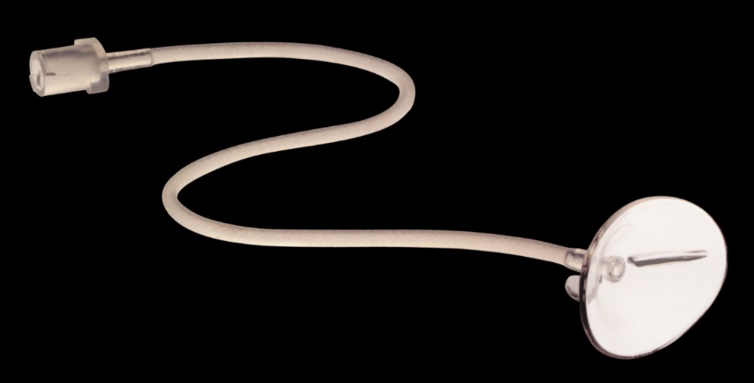
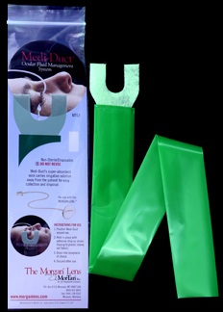
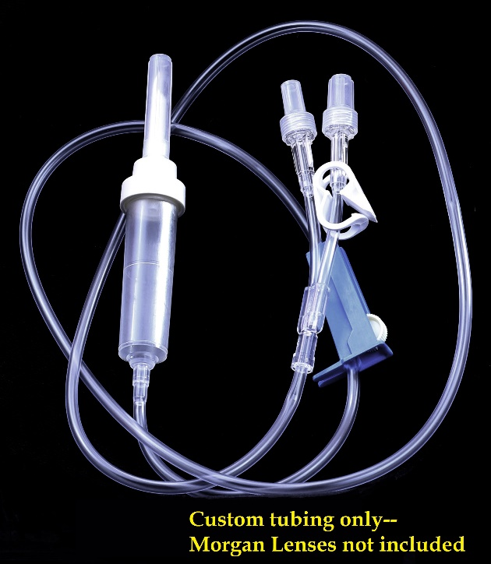
Materials Used for Irrigation with The Morgan Lens
Morgan Lenses (1 or 2)
Note: Pain in one eye may mask pain in other--irrigate both
unless injury is known to be limited to one eye
Morgan Lens Delivery Set® (or I.V. set)
Medi-Duct ® (or towels) to
absorb outflow
Suitable Irrigation Solution—
lactated Ringer’s (Hartmann’s
Solution) recommended
Optional materials:
-Topical ocular anesthetic if available
-pH paper
Notes:
The Morgan Lens has a standard luer lock adapter that can attach to an I.V. set or a Morgan Lens Delivery Set which can provide irrigation to one or both eyes.
Morgan Lens Delivery Set:
-a specialized tubing set (giving set)
-branches to allow attachment to two Morgan Lenses
-provides simultaneous irrigation of both eyes (clamp included to allow irrigation of one eye)
-eliminates the need for two separate bags of solution, tubing sets, and I.V. poles
Medi-Duct:
-an ocular fluid management system
-designed specifically for use with the Morgan Lens
-attaches to the face below the irrigated eye
-wicks away irrigating fluids with super absorbent material keeping patient dry
-allows for easy collection and disposal
Topical Anesthetic:
-not required when using the Morgan Lens
-may reduce patient anxiety, ease the insertion of the lens
-reduces reflex squeezing action of lids (blepharospasm)
-may be reinstilled during irrigation by temporarily pinching tube of the Morgan Lens while placing a drop into the eye (removing the lens from the eye is not necessary)
Irrigating Solution:
-lactated Ringer’s (LR) recommended due to the similarity in pH to that of the eye
-Hartmann’s solution is very similar to LR and may be used when available
-some patients experience irritation with Normal Saline—switching to LR has been shown to relieve pain
-experts recommend using any safe solution—do not delay irrigation to find an ideal solution
pH paper:
-allows medical staff to test pH level in eye(s)
-pH may be taken by temporarily pinching the tube of the Morgan Lens to stop the flow
-irrigation should be continued until the pH is neutral and remains stable

Slide 8
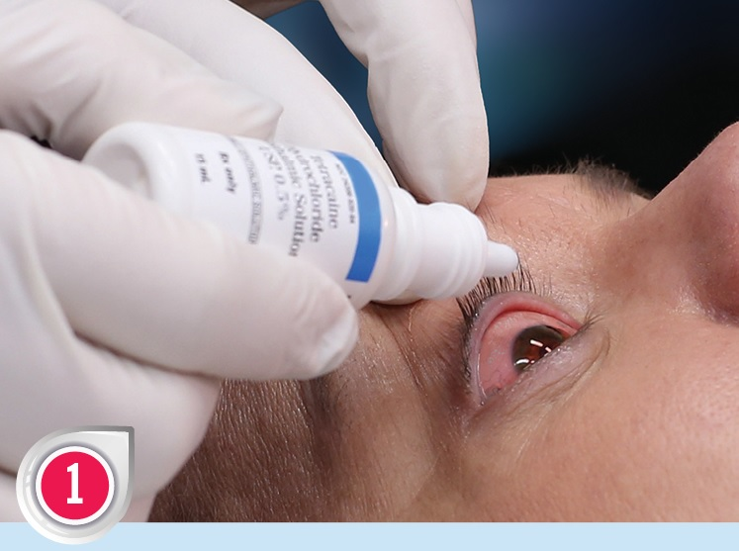
Morgan Lens Insertion
Step One:
Instill topical ocular anesthetic (if available)
Note:
Anesthetic is not required but may help relieve blepharospasms and pain
*DO NOT DELAY IRRIGATION TO REMOVE CONTACT LENSES unless it can be done rapidly. Instead, irrigate over lenses as they may be easier to remove later.
Notes:
Insertion, Step One:
-Ensure the patient does not have any allergies which would prevent using an anesthetic.
-If available, instill topical anesthetic (pain and blepharospasms—the involuntary reflex action of squeezing the eyelids shut--may be relieved by an anesthetic, thereby helping with insertion).
Irrigation with the lens may still be performed if anesthetic isn’t available. The irrigating solution will cool and soothe the eye, dilute the contaminant, and the eyelids may be shut.
Note that anesthetics may mask the feeling of a foreign body, so for the removal of particulates or for a foreign body sensation, it may be best not to use an anesthetic
-DO NOT DELAY IRRIGATION to remove contact lenses unless it can be done rapidly. Instead, irrigate over the lenses as they may be easier to remove later. Chemically-contaminated lenses should be discarded.

Slide 9
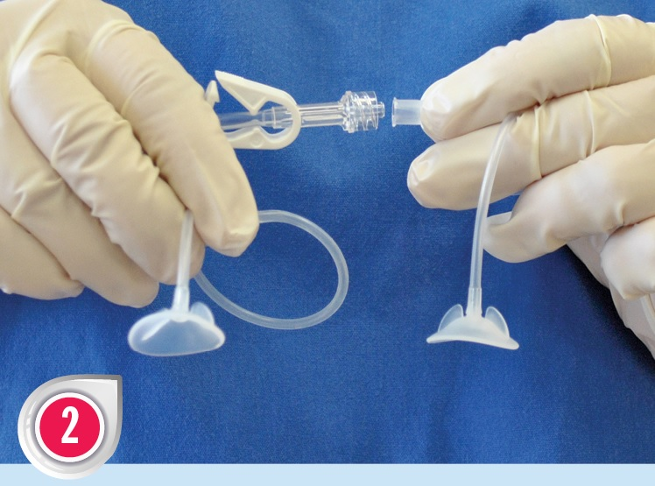
Morgan Lens Insertion
Step Two:
Attach a Morgan Lens Delivery Set
Two lenses may be attached to one Delivery Set to simultaneously irrigate both eyes
Standard I.V. sets or a syringe may also be used
Notes:
Insertion, Step Two:
-Attach the Morgan Lens to a Morgan Lens Delivery Set or a standard I.V. set
-For a smaller, more controlled dosage (including foreign body removal), a syringe may be used
-The pain in one eye may mask pain in the other, so consider irrigating both eyes unless there is clear evidence that only one is involved. -Bilateral irrigation may be done using two Morgan Lenses and two I.V. setups or one Delivery Set

Slide 10
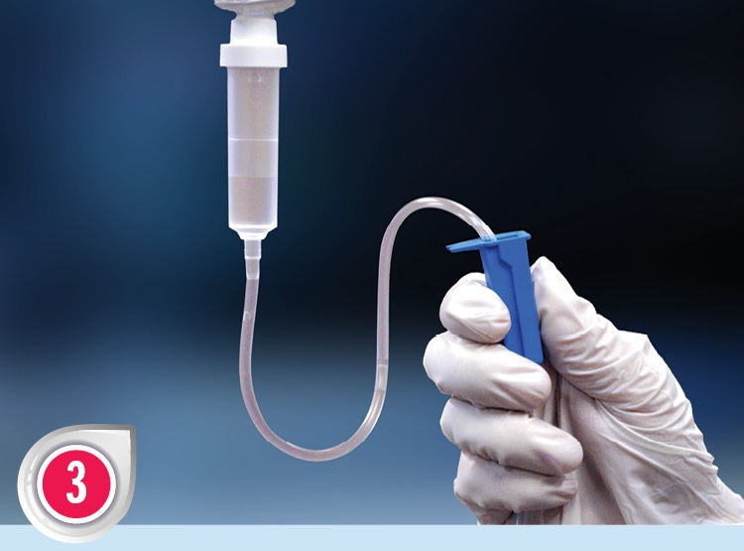
Morgan Lens Insertion
Step Three:
Using solution and rate of choice,
START FLOW.
This allows the lens to “float” over the cornea and sclera.
Continue the flow of solution until after the lens is removed
Notes:
Insertion, Step Three:
-Start a minimal flow of the irrigating solution BEFORE insertion. This immediately starts the irrigation process plus it allows the lens to float on the solution after insertion.
MorTan recommends the use of lactated Ringer’s Solution (Hartmann’s Solution) although any safe fluid may be used to start irrigation as quickly as possible.

Slide 11
Morgan Lens Insertion
Step Four:
Have patient look down, insert lens under upper lid.
Have patient look up, retract lower lid and drop lens in place.
Release lower lid over lens.
Note that sclera is exposed when patient looks down
Notes:
Insertion, Step Four:
-Maintain a minimal flow of irrigating solution.
-Have the patient look down. This exposes the tough and less-sensitive sclera (and the patient is not looking at the lens)
-Insert lens under the upper lid
-Have the patient look up, retract the lower lid, and drop lens into place
-Release the lower lid over the lens
Note that if a patient is unable or unwilling to comply with verbal instructions (too young, unconscious, etc.), the Morgan Lens may be inserted without requiring the patient to look down.

Slide 12
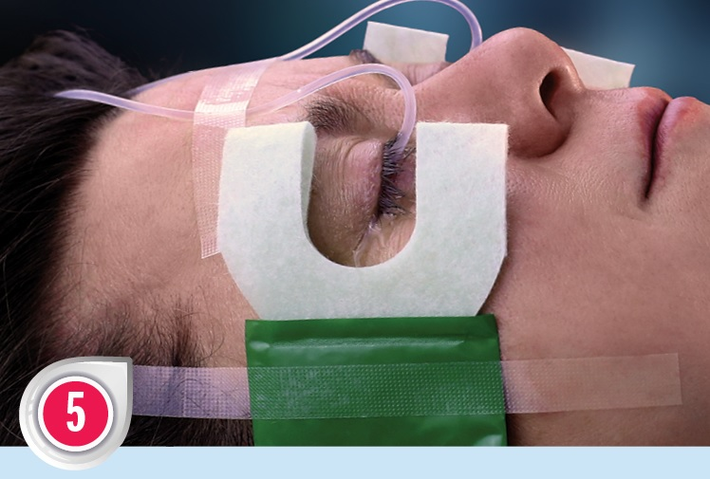
Morgan Lens Insertion
Step Five:
Adjust the flow to the desired rate
Secure a fluid collection device such as the Medi-Duct to the side of patient’s face
Continue irrigation until pH of eye returns to normal
DO NOT RUN DRY
Tape tubing to patient’s forehead to prevent accidental removal
Notes:
Insertion, Step Five:
-The flow may be adjusted to the desired rate (see MorTan’s Recommended Uses Chart)
-A Medi-Duct may be taped to the side of the patient's face to direct the outflow into a basin or other receptacle. Towels, blue pads, or an emesis basin may also be used.
-Taping the tubing to the patient’s forehead may prevent accidental removal.
-For chemical burns, irrigation should be continued until the pH returns to normal and remains steady. This may take at least 2 to 3 hours for alkali burns, but often longer.
CONTINUE THE FLOW OF SOLUTION UNTIL AFTER THE REMOVAL OF THE LENS-the solution gently pushes the lens away from the cornea and provides a cushioning layer for the lens to float on
Note that if the fluid is stopped, the lens is designed to vault the cornea and will not touch it, instead contacting the sclera

Slide 13
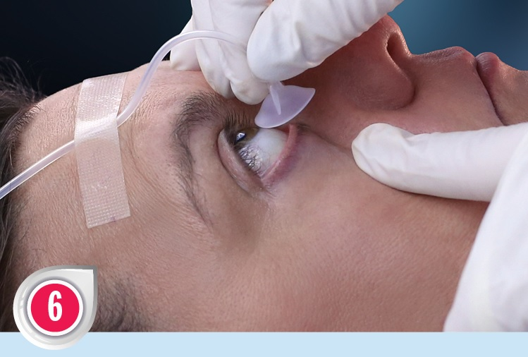
Morgan Lens Removal
Step Six:
CONTINUE FLOW
Have patient look up
Retract and hold lower lid
Slide Morgan Lens out
TERMINATE FLOW
After removal, check ocular pH every 5 to 10 minutes to ensure stability
Notes:
Continue flow of irrigating solution until the lens has been removed—DO NOT RUN DRY so that the lens continually floats above the cornea
Temporarily store the lens in a clean location (such as the opened package) and check the ocular pH after every 5 to 10 minutes to ensure that it has not changed. Reinsert lens and continue irrigation if necessary. Once the pH has stabilized, discard the used Morgan Lens and other materials according to your hospital’s disposal protocols.
--See Morgan Lens Instructional Chart for additional instructions or for the treatment of other injuries--

Slide 14
Irrigation Times
For Irritants:
20 to 30 minutes minimum
For Acids and Alkalis:
Irrigate with at least 2 liters of fluid per eye
Check pH of medial canthus
If neutral, remove lens, wait 5-10 minutes
Measure pH of medial canthus
Repeat until pH remains between 7.5 and 8
For very strong acids or alkalis, continue irrigation for 2 hours after reaching surface pH of 7.5-8.0 to ensure neutralization of the anterior chamber
Notes:
If the offending agent is not chemically reactive (irritants, solvents, non-embedded foreign bodies, etc.), experts usually recommend using 1 liter of solution or irrigating for approximately 30 minutes. For acids and alkalis, the measurement of conjunctival pH can be used to determine the stopping point as described below.
When checking for pH stabilization, the lens should be stored in a clean, particle-free location (such in the original package) in case further irrigation is necessary.
The normal pH of tears is 6.5 to 7.6, but when measured in the cul-de-sac, the pH is closer to 8. Therefore, 7.5 to 8 is a reasonable stopping point. In order to measure the pH of the eye and not the irrigating solution, pinch the tube of the Morgan Lens to temporarily stop the flow of solution and measure the ocular pH in the medial canthus; it is not necessary to remove the lens.

Slide 15
Questions for Patients Do NOT delay irrigation to take patient history*
When did injury occur?
What substance was involved?
Is the patient on any medication or allergic to any medications?
Was the patient wearing safety glasses when injury occurred?
Are there any other injuries?
Did patient receive any prior treatment?
From Nursing 2000, Volume 30, Number 8
*Removal of contact lenses (when necessary) should be done ONLY IF IT DOES NOT DELAY irrigation-removal may be easier after a period of irrigation.
Notes:
BEGIN IRRIGATION FIRST, ASK QUESTIONS LATER
The severity of the injury depends upon:
Length of contact time, pH (molarity), concentration, viscosity, volume, and physical form of contaminant, heat created by reaction, and associated toxic substances.
DO NOT DELAY the initiation of irrigation to remove contact lenses. Contacts were once thought to trap chemicals underneath or to absorb vapors in the air. Studies have shown that neither of these occur, at least with the chemicals studied. Contact lenses, either hard or soft, may actually form a barrier that prevents or lessens chemical burns, and soft contacts do not increase exposure of the cornea to vapors (Journal of the Contact Lens Association of Ophthalmologists, January, 1992, and summarized in Scientific American, April, 1998)

Slide 16
Contraindications
Protruding foreign body
Penetrating eye injury
Suspected or actual rupture of the globe
Do not instill anesthetic agents if allergies are known
Notes:
The Morgan Lens may be used with non-embedded foreign bodies, but DO NOT USE if there is any type of penetrating eye injury or a protruding foreign body.
Ensure the patient does not have any known allergies to ocular anesthetics if used

Slide 17
Lactated Ringer’s vs. Normal Saline
MorTan recommends the use of lactated Ringer’s
(Hartmann’s Solution)
pH closer to that of tears
pH of tears: approximately 7.1
pH of lactated Ringer’s: 6.0 to 7.5
pH of Normal Saline: 4.5 to 7.0
Increased patient tolerance Normal Saline may cause discomfort and/or morphological
changes to the eye*
Buffering capacity
lactated Ringer’s solution returns pH to neutral more quickly
with either acidic or basic contaminants*
*from independent studies
Notes:
MorTan, Inc. recommends the use of lactated Ringer's solution for irrigating due to pH:
-tears pH: approximately 7.1
-lactated Ringer's pH: 6.0-7.5
-Normal Saline pH: 4.5-7.0
(variations are due to different batches or manufacturers of the solutions)
The buffering capacity of the lactate ion found in lactated Ringer's solution returns the pH to normal more quickly when used with either acidic or basic contaminants*
Normal Saline may cause discomfort and/or morphological changes*
Lactated Ringer’s solution is very similar to Hartmann’s Solution
*from independent studies

Slide 18
Suggestions for the
“Difficult Patient”
Reassure patient: insertion will quickly relieve pain.
Any delay will cause further damage.
Seconds count!
The irrigating solution provides cooling and soothing sensation
The injured cornea is protected from “squeegee” action of eyelids each time the patient blinks
Remind them their eyes may be closed during procedure
Chemicals may generate heat when mixed with water- irrigation will cool the eye
Remember: the Morgan Lens does not touch the cornea
A topical anesthetic may help relieve anxiety
Additional anesthetic may be instilled without removing lens. Pinch tubing and instill drop into medial canthus.
Notes:
Assure the patient that the irrigating solution will be soothing and cooling and, by inserting the Morgan Lens, the eyelids may be closed. The fluid will immediately begin diluting and removing the contaminant and alleviating pain. The alternatives require that the eye be opened (fighting blepharospasms and photophobia) and often do not deliver sufficient fluid to the injury so that neutralization is prolonged.
Explain that you will only need a few seconds to insert the lens, briefly touching the possibly-sensitive skin around the eye, and as soon as the lens is in place, no further contact is necessary.
By having the patient look down (Step 4 in the Instructions for Use), the person is not looking at the lens while it’s being approaching the eye, plus the sclera is less sensitive and tougher than the cornea.
Keep in mind the extra anxiety that is generally associated with an ocular injury and reassure the patient that you are using the best treatment method available.
Use common sense: telling a patient "this is going to hurt" almost guarantees that a procedure will (especially with children). Instead, saying "this will feel cold“, unless you've warmed the solution, or reminding them that the lens will not be touching the cornea (since it floats on the irrigating solution) may help relieve anxiety.
If using Normal Saline, remember that its low pH may make it difficult for some patients to tolerate (especially for long term). Switching to lactated Ringer's (Hartmann's solution) may help as their pain may be coming from the irrigating solution and not the irrigation procedure. Do not delay irrigation in order to find the best solution—begin irrigation as quickly as possible.
Ensuring that all materials are readily available by having an eye cart or tray may eliminate delays in starting irrigation.
It may help to have a parent hold a small child during the irrigation process.

Slide 19
Benefits of the Morgan Lens
100% of irrigating solution is delivered directly to cornea, cul-de-sac and conjunctiva (even when eyes are closed)
Frees medical staff to attend to other injuries
Patient can be transported during procedure
Patient rests comfortably
Highly cost effective
There is minimal contact with the injured skin surrounding the eye
Symblepharon (adhesion) formation is prevented
Notes:
Benefits of using The Morgan Lens:
-even if the eyes are tightly squeezed shut (the reflex action), all of the irrigating solution is delivered to cornea, cul-de-sac and conjunctiva
-the eyelids balloon out slightly, providing a smooth inner surface (instead of forming pockets that trap materials as happens when the eyelids are retracted)
-because the irrigation process is hands-free, medical staff may treat other injuries or even other patients
-irrigation should not be stopped while the patient is being transported
-patients can close their eyes rather than having a medical provider force the eyelids open
-by reducing the need for follow-up care and by allowing medical providers to tend to other tasks, the cost of the lens is easily offset
-if the skin around the eye is burned, it is only necessary to touch the area during the insertion of the lens
-adhesions (symblepharon) formation may occur following chemical burns, but it is prevented with the lens

Slide 20
Issues with Alternative Methods
The eyes must be manually held open or the patient has to blink repeatedly for the fluid to reach the cornea
Keeping the eyes open may be extremely painful
Fluid will take the “path of least resistance” and simply flow off the surface rather than flushing the fornices
Locating components and assembly may be required
Retracted eyelids may have pockets that can trap chemicals
Continual contact with burned skin around the eye may be necessary to keep the eye open
Full-time attention is required for the irrigation process
Notes:
Irrigation should be started as quickly as possible using any available method and safe fluid. However, the Morgan Lens should be in place promptly in order to ensure effective irrigation.
The Morgan Lens eliminates the problems associated other methods of irrigation. Some of these issues are:
-at least one medical provider is needed to hold the eyelids open (possibly more for bilateral irrigation or for treating children)
-an increased sensitivity to light (photophobia) and the reflex action of the eyelids (blepharospasms) make it painful to keep the eyes open during the irrigation process
-the fluid is not directed under the eyelids so that much of it will run off the surface, never reaching into the fornices or flushing the inner eyelids
-some irrigation methods require materials that may not be readily available in the ER or need modification
-it may be difficult to effectively irrigate the folds formed when retracting the eyelids, and any trapped particulates or chemicals may continue to contaminate the eye
-continual and painful touching of the burned skin around the eye may be required to keep the eye open in order to deliver fluid to the cornea
-medical personnel are not free to treat other injuries or patients
From Emergency Medical Response to Hazardous Materials Incidents (Stilp and Bevelacqua, Delmar Publishers, 1997):
“Eyelids provide a watertight, airtight seal when tightly closed, so irrigation without opening the lids is useless.”
“Once a caustic substance reaches the eye…the lids are forced closed in a natural response to the injury… The medical provider arriving on the scene is faced with two problems in irrigating the eye. First, holding the eye open in an attempt to irrigate the globe properly is extremely difficult or at times impossible without specialized equipment. This is not because the patient is uncooperative but because the patient is unable to open the eye due to the spasm. Second, there is no efficient way one person can pour the solution into the eye once the lids are opened digitally.”
Morgan Lenses “are comfortable to the patient and provide a better irrigation to an injured eye than a medical provider struggling to hold open an injured eye while providing a steady flow of solution over the globe.”

Slide 21
Summary
Burns are among the most urgent of ocular emergencies
Copious irrigation must be started quickly (at scene of accident if possible)
All surfaces of the eye (cornea, sclera, cul-de-sac, and inner eyelid) must be flushed thoroughly
Irrigation should be continued until pH of eye returns to normal (alkali burns may require hours of continuous irrigation; severe infections may require irrigation for hours or even days)*
*See MORGAN LENS USES CHART available at morganlens.com
Notes:
Summary:
-loss of vision is considered one of the most debilitating of injuries, and ocular burns may lead to blindness if not treated quickly and effectively
-irrigation should be prompt and prolific; any delays may alter the prognosis
-it is essential that the irrigating solution reach all regions of the eye and a sufficient volume of fluid must be used
-burns may require hours of irrigation in order to neutralize the pH (and to ensure that the pH remains neutral)
-irrigating continuously for days may be necessary to effectively treat severe infections

Slide 22
The World’s Leader in Ocular Irrigation
For more information, or to order the Morgan Lens, contact:
MorTan, Inc.
P.O. Box 8719
Missoula, MT 59807 USA
Phone: 1-800-423-8659
or (406) 728-2522
Fax: (406) 728-9332
morganlens.com email: mortan@morganlens.com
© 2018 Rev. D MorTan is an ISO 13485 registered company
Please do not duplicate or modify without permission from MorTan, Inc.
Notes:
Speaker notes were compiled using numerous sources including:
“Burns, Ocular” by Wende R. Reenstra-Buras, MD
http://www.emedicine.com/EMERG/topic736.htm
“Burns, Chemical” by Robert Cox, MD
http://emedicine.medscape.com/article/769336-overview#a4
Principles and Practices of Emergency Medicine (Third Edition, Schwartz, et.al.)
“Go With the Flow During an Eye Emergency”, Nursing 2000, Vol. 30, No. 8

